Slide 1

Generating Tree Genus Classification and Change Maps to Assist Mitigate Climate Change
Pedro Junio
September 3, 2024
Notes:
Hello everyone. I will be presenting my research on generating tree genus classification and change maps to assist in mitigating climate change. This study integrates Sentinel-2 satellite imagery and climate data to enhance tree genus classification accuracy and understand the impact of climate changes on tree distributions. Let’s get started.

Slide 2
Introduction
▶ Overview of tree genus classification
▶ Use of Sentinel-2 data and climate variables
▶ Objectives of the study
Notes:
The main objectives of this research were: 1) To develop a robust classification model for tree genera using Sentinel-2 imagery, 2) To analyze how different seasonal and band combinations impact model performance, 3) To evaluate the influence of climate variables on tree genus distributions, and 4) To assess the effectiveness of incorporating climate data into the classification process for understanding changes in tree distributions.

Slide 3
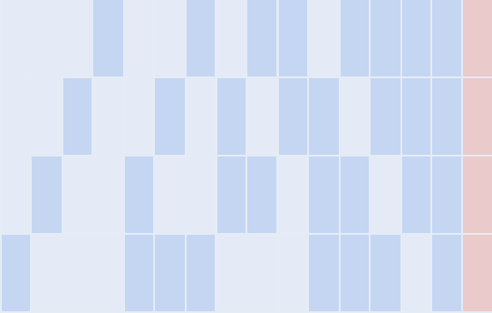
Sentinel-2 Seasons
▶ Performance across different seasons
▶ Metrics: recall, precision, weighted f1-score, PRC AUC, ROC AUC
▶ Optimal seasons for classification
recall
precision
weightedf1score
prc
auc
0.95
winter
0.9
autumn
0.85
Metrics
0.8
summer
0.75
spring
0.7
Combinations
Notes:
The main motivation behind feature selection was that the full dataset can approach 1 Terabyte. The figure on this slide presents the performance of the convolutional neural network model across different seasonal combinations, and it can be quite detailed, so let's break it down.
The y-axis shows the performance metrics of the model, while the x-axis represents the different season combinations used for training and validation. For example, the leftmost point represents the model trained using only spring data, while the rightmost point represents the use of all available seasons.
The red combination highlights the use of Long Short-Term Memory (LSTM) in addition to convolutions, which aims to capture temporal dynamics alongside spatial patterns. Unfortunately, it showed no improvement over using only convolutions.
Various metrics were used but for simplicity I would like to focus on the weighted f1-score.
A key takeaway from this figure is that including multiple seasons does not substantially enhance the model's performance compared to using just summer data. However, using all seasons considerably increases the data volume by over 500 Gigabytes.
This suggests that adding more seasons might offer slight improvements in accuracy, but the trade-off in storage and processing requirements may not be justified. Hence, I focused on summer months only.

Slide 4
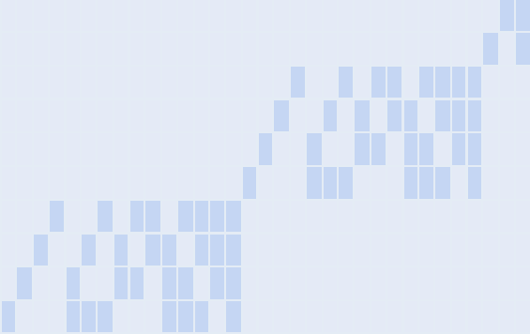
Sentinel-2 Bands Part I
▶ Band selection and its impact on performance
▶ Analysis of band groups
recall
precision
weightedf1score
prc
auc 0.95
B12
B11
0.9
B8A
0.85
B8
0.8
Bands
B7
Metrics
0.75
B6
B5
0.7
B4
0.65
B3
0.6
B2
0.55
Combinations
Notes:
A similar analysis was conducted for the Sentinel-2 bands, which involved evaluating approximately 1,000 different band combinations.
Due to the extensive number of combinations, the analysis was divided into two steps. The initial step, as shown here, involved grouping the bands by similarity to simplify the evaluation process.
Focusing on the weighted F1 score for simplicity, there are notable differences in performance among the various combinations.
For example, a significant difference of nearly 10% is evident between using the band B2 alone and the combination of bands B2, B3, and B4.

Slide 5
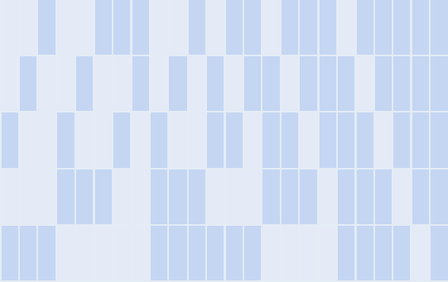
Sentinel-2 Bands Part II
▶ Optimal band combination for classification
recall
precision
weightedf1score
prc
auc
0.95
B11
0.9
B8
0.85
Bands
0.8
Metrics
B6
0.75
B3
0.7
B2
0.65
Combinations
Notes:
In the second step of the analysis, bands with an acceptable trade-off in score loss were evaluated.
The combinations now showed smaller variability in score loss. Notably, 3-band combinations like B3, B8, and B11 performed nearly as well as using all bands.
I decided to select the 4 bands: B3, B6, B8, and B11, as they offered a good balance between performance and data size. This choice reduced the dataset size from about 200 Gigabytes to 50 Gigabytes. Alternative 3-band and 2-band combinations also seemed viable.

Slide 6

Soil and Elevation Data
▶ Integration of SoilGrids and elevation data
▶ Performance comparison with Sentinel-2 data
▶ Impact on model accuracy
recall
precision
weightedf1score
prc
auc
0.9
elevation
0.8
0.7
Metrics
soilgrids
0.6
sentinel
0.5
0.4
Combinations
Notes:
Curiosity led me to integrate soil composition and elevation data into the analysis.
However, these additional sources provided little improvement over using Sentinel-2 data alone, as shown in the figure.
It’s worth noting that SoilGrids, the soil composition dataset, performed relatively well by itself, with an F1 score only a few percentage points below that of Sentinel-2.

Slide 7
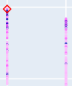
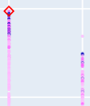
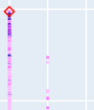
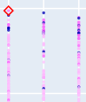
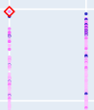

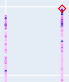
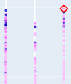
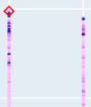
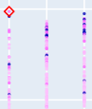
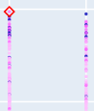
Neural Network Configuration I
▶ Initial hyperparameter tuning
▶ Parameters and their impact
▶ Results from Hyperband trials
class weight
training years
kernel regularizer
spatial dropout
activation
0.7
epochs
100
0.6
true
false
2017
2017
l1l2
l2
l1
0.1
0.3
0.5
relu
leaky
score
2018
relu
pool size
2019
bias initializer
learning rate
loss function
dropout
0.7
0.6
2
2
4
0.1
0.3
0.5
true
false
0.001
0.01
binary
binary
0.0001
focal
crossentropy
crossentropy
Notes:
Hyperparameter optimization was conducted in two phases. Initially, I explored a broad search space to identify promising parameters. The figure highlights effective configurations, with the most effective marked by diamonds.
While some hyperparameters had minimal impact, others, such as class weights, training years, and kernel regularizers, led to notable improvements.
It's worth noting that "training years" is not a classic hyperparameter but rather a choice between training the model with data from 2017 alone or data from 2017 to 2019.

Slide 8
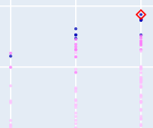
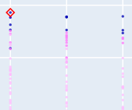
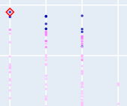

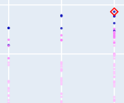
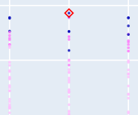
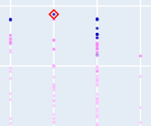
Neural Network Configuration II
▶ Follow-up hyperparameter tuning
▶ Optimization of layers and units
▶ Optimal configurations for performance
ﬁlter size min
ﬁlter size max
residual blocks
0.7
epochs
30
0.6
score
32
64
128
256
512
1024
2
3
4
5
units min
units max
dense layers
0.7
0.6
2
64
128
256
512
1024
2048
2
3
4
5
Notes:
In the follow-up phase, I fixed the model using the best initial trial and refined it by optimizing filter sizes and units in the dense layers. This process led to the selection of the most effective ResNet-based architecture for the task.
It's important to note that the residual blocks and dense layers were determined by the minimum and maximum configurations rather than being hyperparameters in themselves.

Slide 9
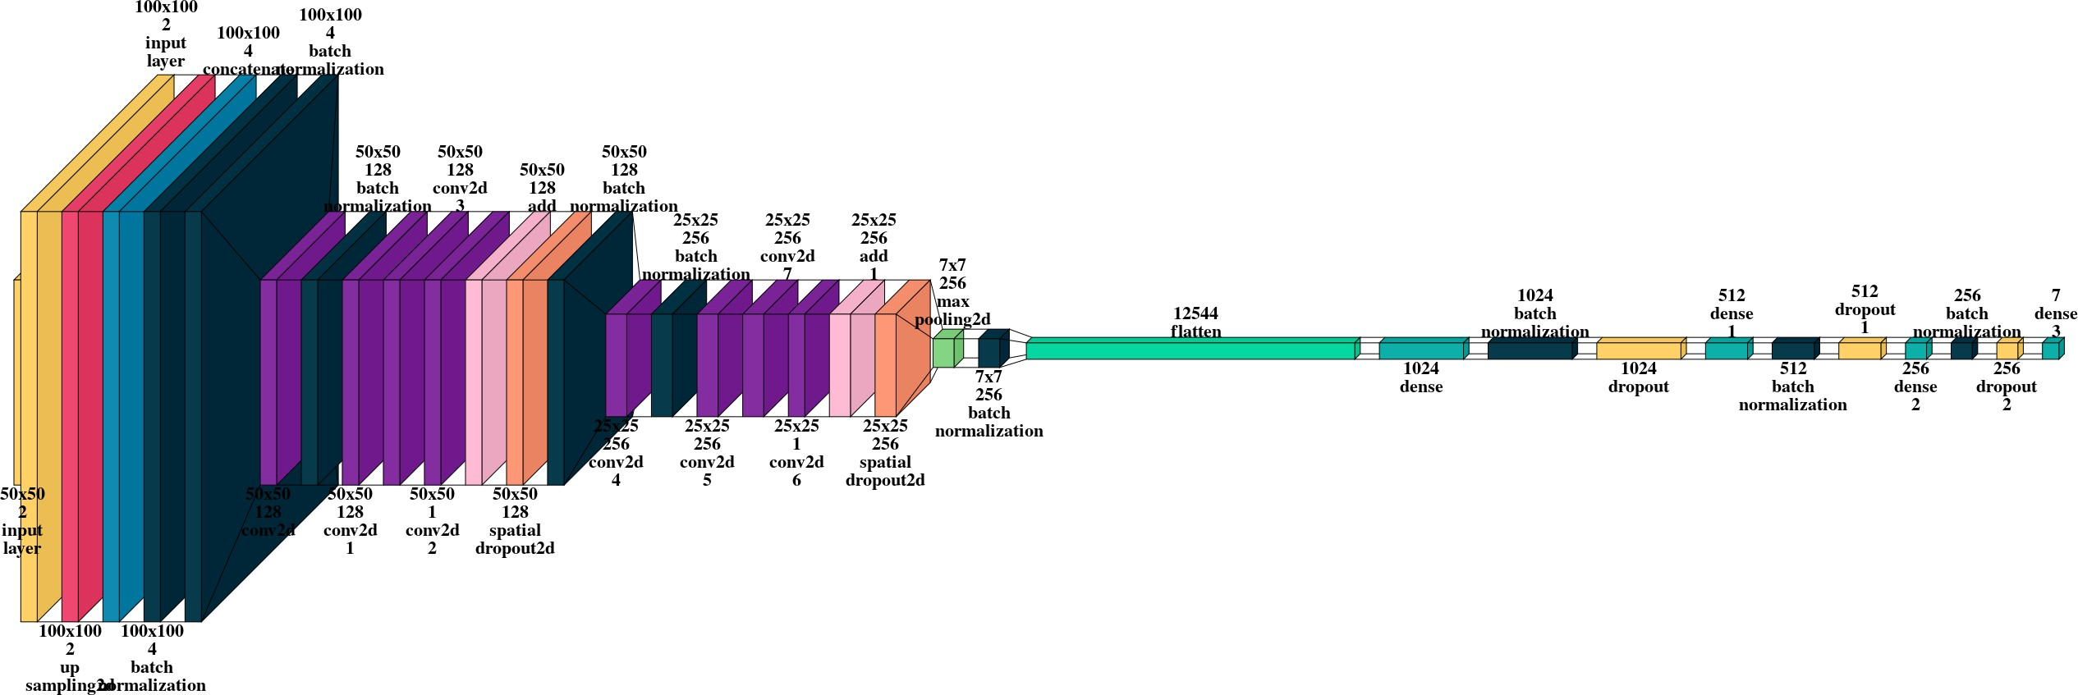
Model Architecture
▶ Overview of model layers
▶ Convolutional and fully-connected layers
▶ Use of residual connections
Notes:
Here's the resulting model architecture. Apologies if some of the text is hard to read.
The model processes 2 inputs: 100x100 pixel images with 2 bands each.
The 20-meter bands are upsampled to 10 meters such that all bands have the resolution of 10 meters.
These images go through convolutional blocks, are then flattened, passed through fully-connected layers, and finally produce an output vector of 7, one for each tree genus.

Slide 10
Dataset Exploration
▶ Description and significance of ERA5 data
▶ Variables considered: temperature, precipitation, soil moisture
▶ Summary of selected variables
0.006
max
300
median
0.75 quantile
0.95 quantile
1.0 quantile
temperature_2m
total_precipitation
0.004
280
0.002
min
median
0.75 quantile
0.95 quantile
1.0 quantile
260
0
dewpoint_temperature_2m
290
volumetric_soil_water_layer_2
0.6
280
0.4
270
260
0.2
250
0
2020 2021 2022 2023 2024
year
2020 2021 2022 2023 2024
year
Notes:
In this part of the study, I focused on selecting key meteorological data relevant to tree genus classification.
The ERA5 dataset offers detailed, high-resolution climate data, including variables like temperature, precipitation, and soil moisture, which are critical for understanding climate impact on ecosystems. There’s a lot more about this dataset that could be said, but that would not fit here.
This figure summarizes the selected variables, showing the median and quantiles for the selected variables on the y-axes for the years between 2020 and 2024.
As you can see on the top left, even though the region is limited to Europe, it covers a relatively broad temperature gradient, as an example.

Slide 11
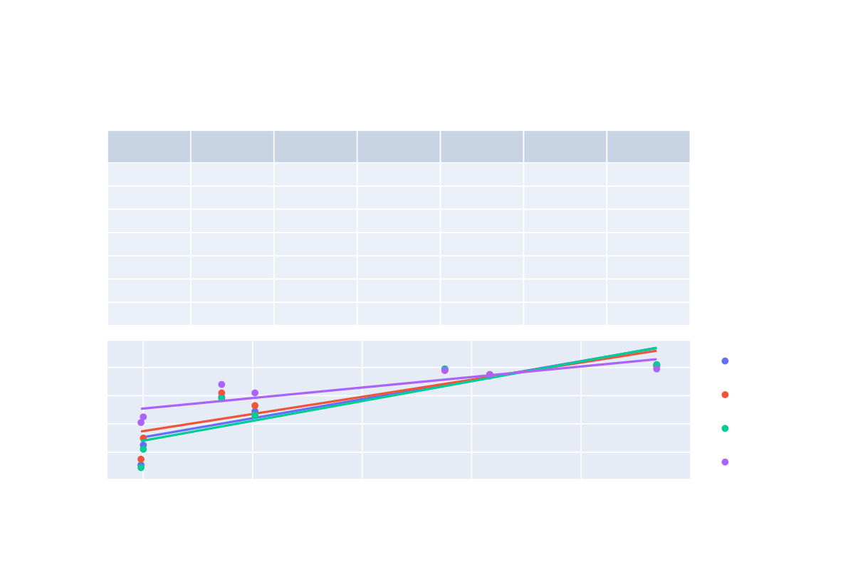
Class Analysis and Validation
▶ ▶
▶
Classification performance varies across tree genera. Genera with fewer training samples exhibit poorer performance. Positive correlation between the number of training samples and accuracy.
genus
f2_score
f1_score
recall
precision
eval_count
train_count
Pinus Picea Quercus Fagus Betula Fraxinus Acer
0.82 0.79 0.75 0.59 0.49 0.25 0.11
0.81 0.78 0.75 0.62 0.53 0.3 0.15
0.82 0.79 0.74 0.58 0.46 0.22 0.09
0.79 0.78 0.75 0.68 0.62 0.45 0.41
4982 3389 3681 1528 1840 872 866
113811 75100 83306 34325 40407 20016 19588
0.8 0.6 0.4 0.2
f2_score f1_score recall precision
score
20k
40k
60k
80k
100k
train size
Notes:
This slide presents the class analysis and validation results.
The model's performance is closely tied to the amount of training data available for each tree genus.
Genera with fewer samples show poorer accuracy, with an f2 score as low as 0.11.
While the most prominent genus shows the highest f2 score of 0.82.
The scatter plot on the bottom illustrates a positive correlation between the number of training samples and the model’s accuracy.

Slide 12
Change Map Correlations
▶ Correlation between tree genus changes and meteorological differences
▶ Short-term vs. long-term impacts of climate change
0.1
Acer Betula Fagus Fraxinus Picea Pinus Quercus
0.05
Pearson coef.
0
−0.05
2020
2021
2022
year
2023
2024
Notes:
I took two approaches to analyze the relationship between tree genera and climate.
The first approach used Pearson correlation to compare changes in tree genera with shifts in meteorological conditions from 2020 to 2024.
The results showed no significant correlations, suggesting that the major tree genera remained stable during this short-term period.

Slide 13
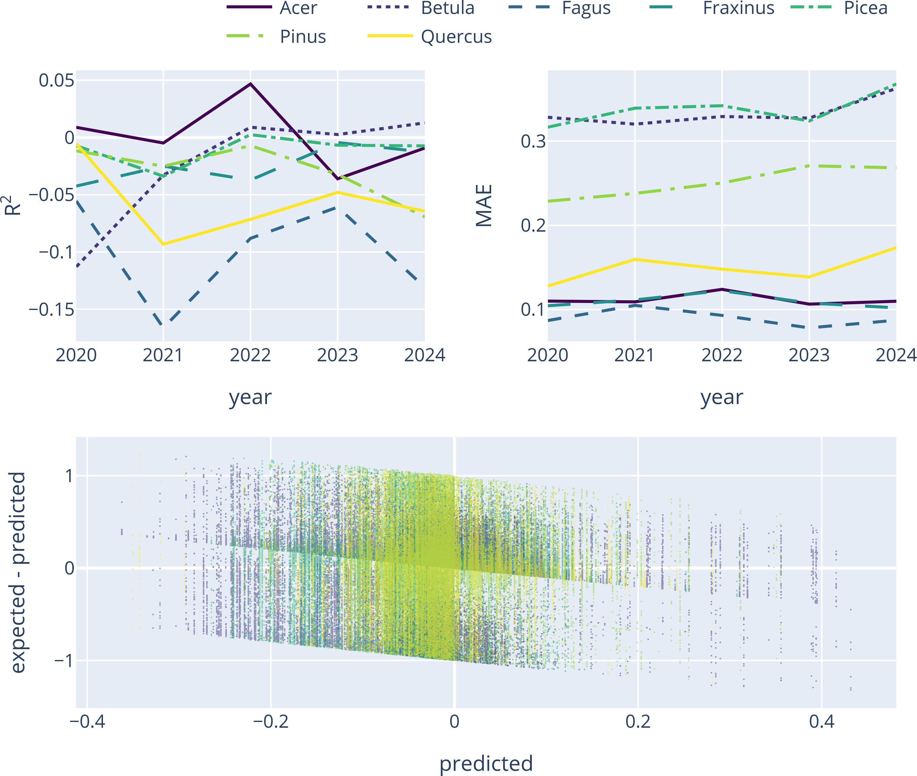
Relationship Modeling
▶ Regression model to analyze climate-tree genus relationships
▶ Metrics: R² and MAE
▶ Model performance and results
Notes:
For the second approach in exploring the relationship between climate change and tree genera, I developed a regression model using meteorological changes as predictors. Despite using a robust approach with a narrow, fully-connected neural network and the Huber loss function, the model performed poorly. The R-Squared values were low or negative, and the mean absolute error values were high, indicating that the chosen climate variables did not meaningfully explain the changes in tree genera distributions.

Slide 14
Summary and Conclusions
▶ Key findings from classification and climate data analysis
▶ Model performance and limitations
▶ Implications and future research directions
Notes:
The classification model identified tree genera with large performance variations based on the amount of training data for each genus. Climate data analysis revealed minimal short-term impacts on prominent tree genera within Europe, although potential long-term effects and impacts on less common species were not explored.
The model demonstrated strong classification accuracy for well-represented genera but struggled with less common ones due to class imbalance. Climate change correlations were limited, suggesting the need for further investigation into long-term trends and less common tree genera.
These findings highlight the effectiveness of current models but also point to the need for additional research. Future studies should explore long-term climate impacts using Landsat, refine models for underrepresented genera, and consider integrating more diverse data sources to improve overall predictive power.

Slide 15
The End
Notes:
This is the end of my presentation. Thank you for listening and I am happy to further discuss the project over email or Teams.

